Slide 1
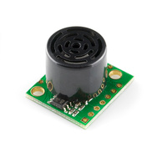
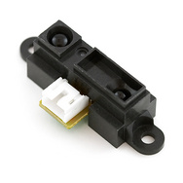
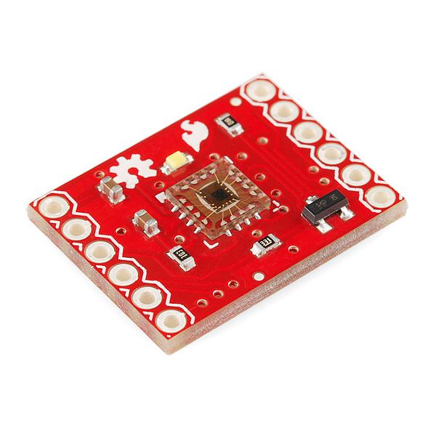
Week 5: Sensors
D Inglis
Alciatore and Histand text Chapter 9

Slide 2
Simple electromechanical sensors
Proximity sensors and switches
Potentiometers
Linear Variable differential transformers
Optical encoders
Strain gages
Load cells
Accelerometers
Gyroscopes
Pressure and flow sensors…
Position and Speed

Slide 3
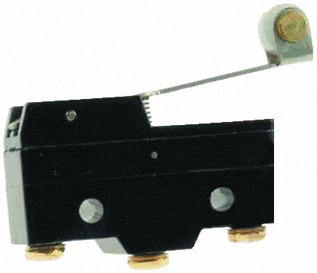
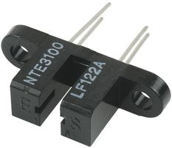
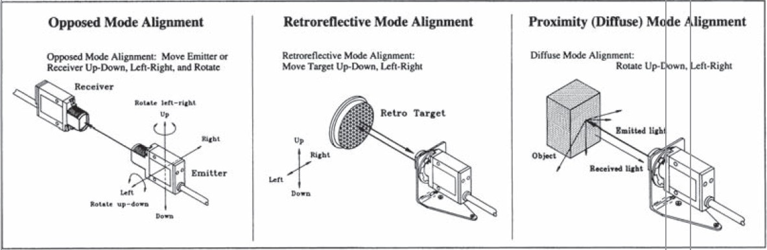
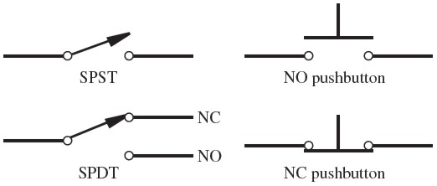
Position and Speed are the most common sensors (other than electrical measurements)
Need to keep track of the position of parts. Very often it is shaft rotation. And linear can easily be converted to rotation through gears.
Non-Contact Proximity Sensors
Ultrasonic
Infrared
Radar and LASER
Non-Contact Proximity Switches
Photoemitter-detector pair: opposed mode, retroreflective, diffuse mode reflective, magnetic, reed switches
Contact Switches
Normally open vs normally closed
SPST, SPDT

Slide 4
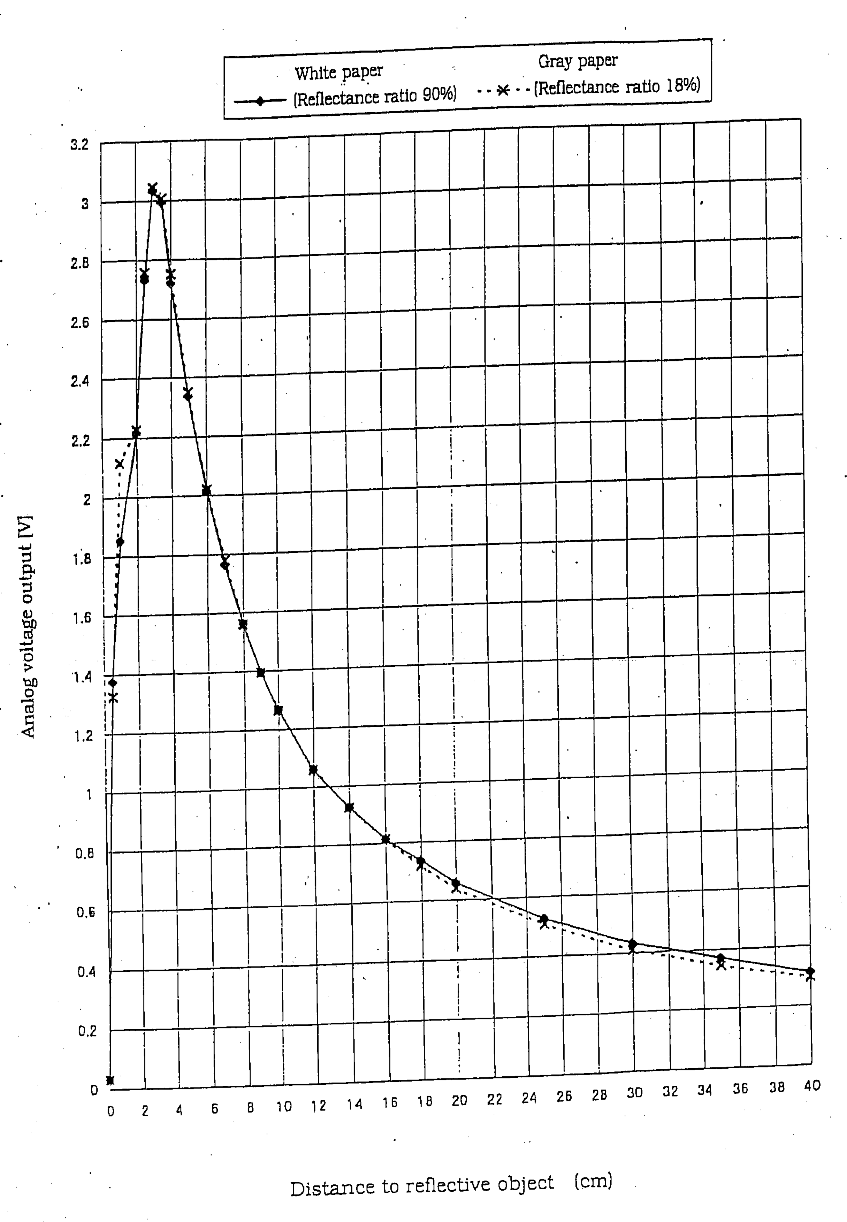
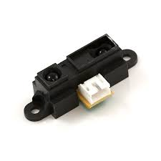
Sensors have a useable Range
Sharp infrared proximity sensor
We have lots of these. Please use them.
Use analog voltage output.
Notes:
View datasheet

Slide 5
Ultrasonic Distance Sensors/range finder
See maxbotics data sheet

Slide 6
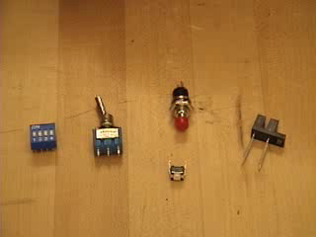
http://www.youtube.com/watch?v=cfK03AN5fSI
Notes:
See arduino tachometer example, plus talk about arduino’s in lab.

Slide 7
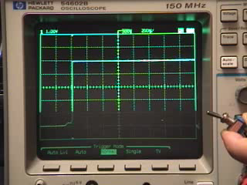
Switch Bounce
http://video_demos.colostate.edu/mechatronics/switch_bounce.wmv
To clean this up you can use
Digital Flip-Flop
Schmitt Trigger (RC plus inverter)
Code, manual and libraries
Switches always have the potential to bounce. Your CPU may check the state of the switch many times during the bounce. Circuits and code an accommodate this preventing a single switch throw from being read as a bunch of switches.
Notes:
Imagine trying to count button pushes without debounce.

Slide 8
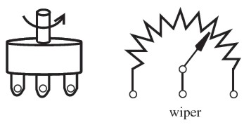
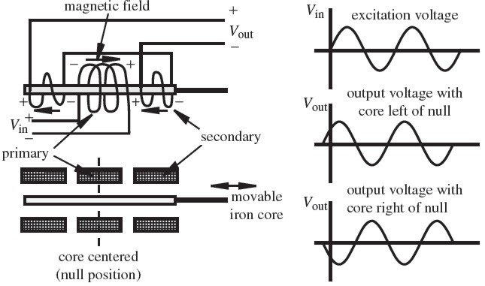
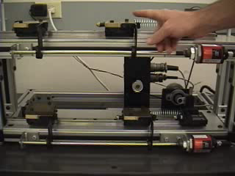
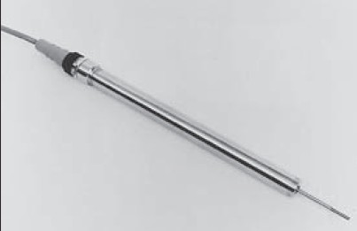
Contact Sensors
Linear Variable differential transformer
Potentiometer, flex sensors. Soft pots. Both in our lab kit
Notes:
Video: http://video_demos.colostate.edu/mechatronics/magnetostrictive_sensor.wmv

Slide 9
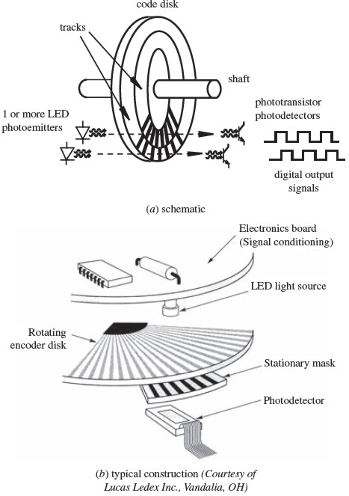
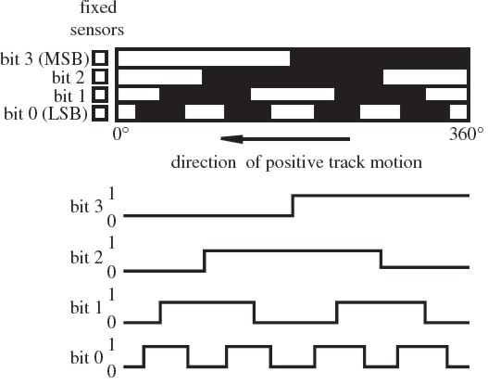
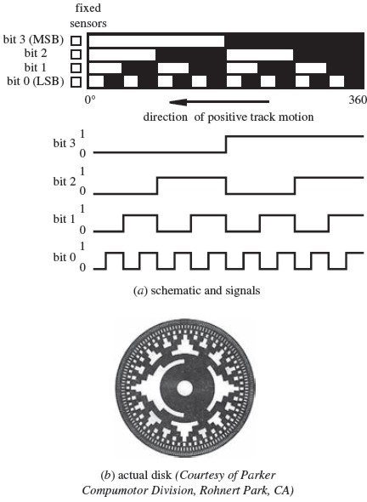
Optical Encoders
Gray code (less uncertainty, ie only one bit flips per transitions)
vs Binary code

Slide 10
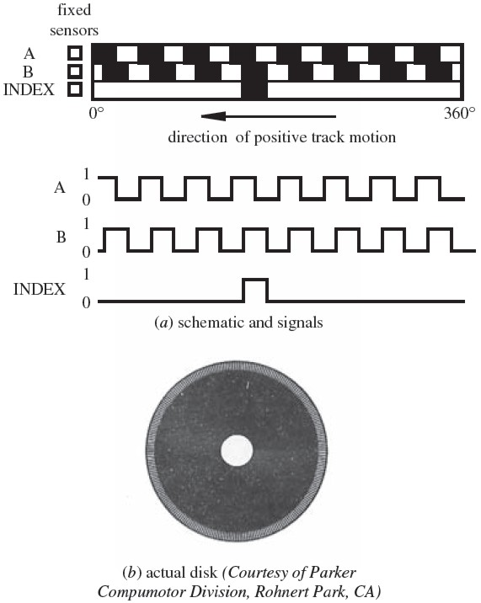
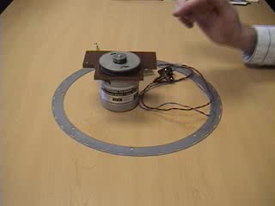
Absolute vs Relative
This relative encoder has offset tracks to give immediate directional information. Also has an index to count rotations.
Notes:
Class discussion item 9.7: When a robotic arm with absolute encoders on its joints is powered up, the robot knows exactly where its links are relative to its base. If the absolute encoders were replaced with incremental encoders, would this remain true? If not, how would the robot establish a home or zero reference position for the arm?

Slide 11
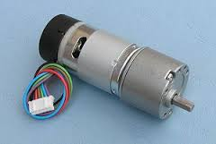
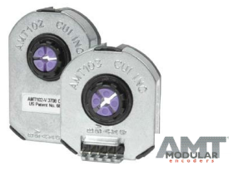
Magnetic and Capacitive Shaft encoders
Matrix Motor example as used by NI ARC team.
AMT10X as use on CNC: http://www.cui.com/product/resource/amt10x.pdf
Also see: http://www.anaheimautomation.com/manuals/forms/encoder-guide.php - sthash.3IiGqGis.dpbs

Slide 12
Accelerometers vs Gyroscopes
Modern ones are tiny vibrating pieces of silicon or other crystal.
Accelerometer measures change in speed. Accelerometers also measure gravity.
Ideally a gyro measures absolute tilt. Vibrating gyros really measure changes in tilt. To get absolute tilt you need to integrate the small changes.
Typically drones and some cell phones have both and use data from both to quickly determine absolute tilt in noisy environments like a vibrating helicopter.

Slide 13
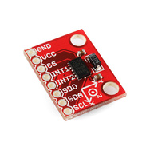
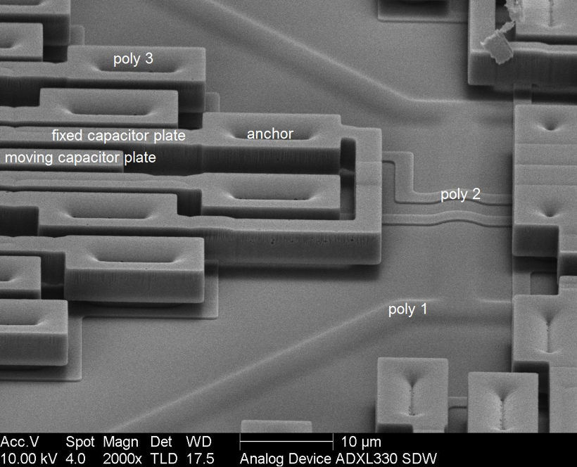
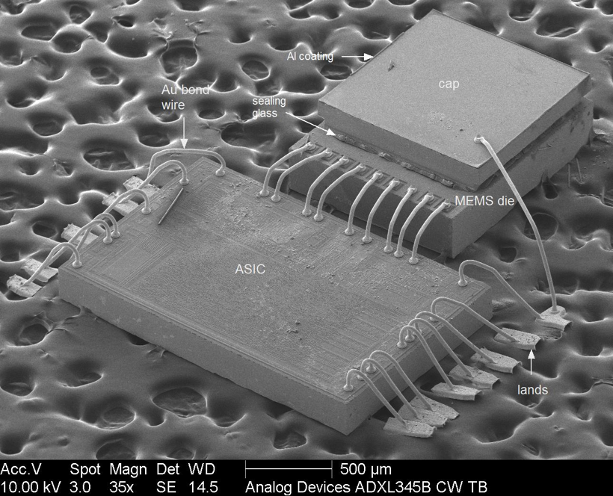
ADXL345 Digital 3 axis accelerometer-$15
Actual chip is 3mm x 5mm 1mm! Tiny.
Applications: handsets, Medical instruments, gaming and pointing devices, industrial instrumentation, personal navigation devices, hard disk drive protection, fitness equipment.
Selectable measurement range (±2, ±4, ±8, ±16 g).
Static acceleration (gravity) means it can be used to measure tilt.
Acceleration is measured using interdigitated polysilicon springs. Capacitance is measured between fixed and free fingers.
Package contains two dies, wired bonded together.
Notes:
ASIC: application specific integrated circuit

Slide 14
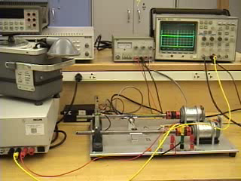
Piezo-electric Accelerometer Example

Slide 15
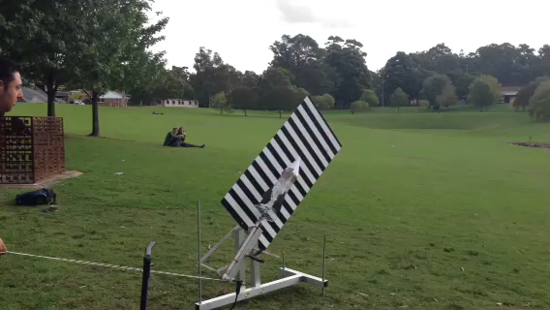
Accelerometers to log data

Slide 16
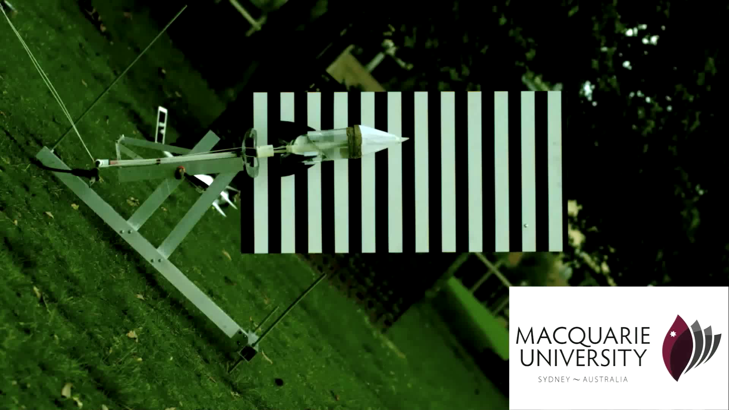

Slide 18
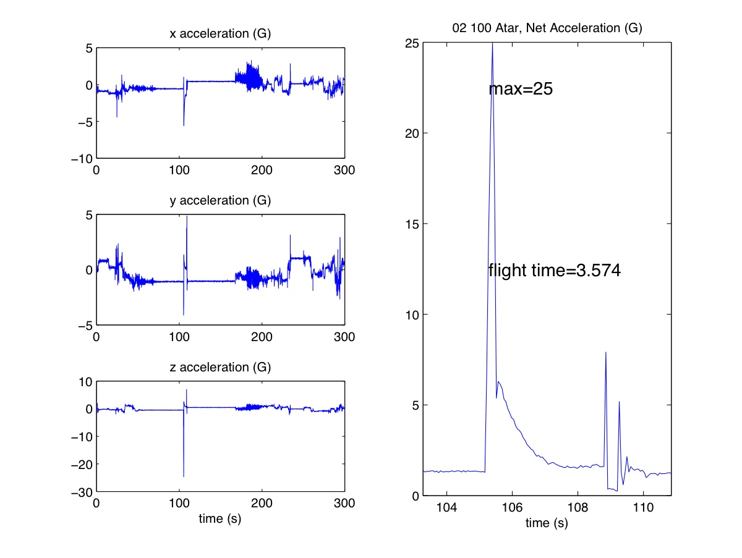

Slide 19
Temperature Measurement
Bimetallic Strip: two strips of metal with different thermal expansion coefficients. Bend when heated.
RTD (Resistance Temperature Device): Typically a platinum wire. It gets more resistive with temperature. Can operate over -220C to 750C!
Thermistor: Semiconductor device whose resistance decreases exponentially with temperature. Highly accurate (0.01C) over a narrow T range.
Thermocouple: produces a voltage proportional to the difference in temperature between to dissimilar metal junctions. Easy to use with long lead wires, typically +/- 1C accuracy.
Thermopile: a bunch of thermocouples in series to increase the voltage
Semiconductors: Uses the temperature dependent gain of a BJT (what we have for the lab). ESD sensitive, not easy to make good thermal contact. Cheap.
Notes:
Look at TMP 34-35-36 data sheet.
What is the output voltage range?

Slide 20
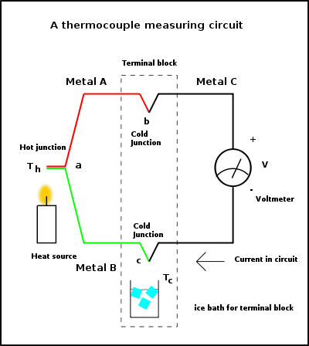
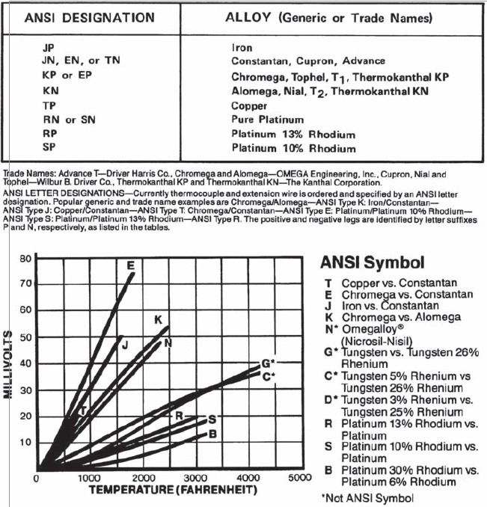
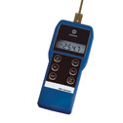
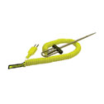
Notes:
Thermocouple data sheets. Many standard types. Interchangeable with readers.

Slide 21
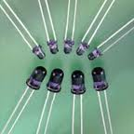
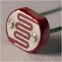
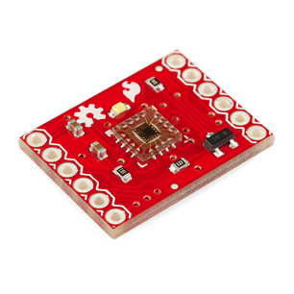
Light Measurement
Phototransistors: silicon solar cell acts as the base in a BJT. Infrared remote controls. cheapish, large dynamic range. Sensitive in near infared (900 nm), fast (5 us)
Photodiode: Same as Photovoltaics. Light generates a small amount of current. If small, then need a measurement circuit.
Photoresistor: A high resistance semiconductor. CdS resistor gets less resistive when illuminated. Sensitive in the visible range (green), cheap, slow (20 ms)
CMOS detector: An array of photodiodes. In most cell phone cameras. Can be integrated into normal silicon process,
CCD detector: Usually higher sensitivity than CMOS, made on separate chips.
Color detection can be done using colored glass or interference filters over semiconductor detectors like photodiodes.
Notes:
See OSRAM grey phototransistor data sheet
See CdS data sheet

Slide 22
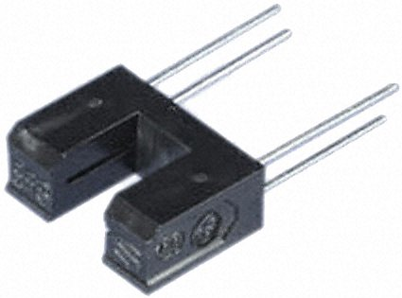
Photo interrupter
Design a circuit to provide pulses to a digital system for a digital tachometer using a 4-pin photo interrupter.
Start with data sheet
Notes:
Get to how to use it. Draw example circuit

Slide 23
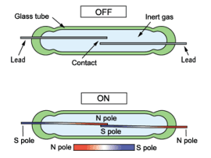
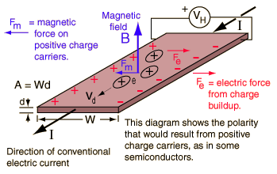
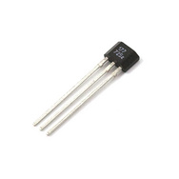
Magnetic Field Measurement
Reed switch
Limit switches, rotational counters
Hall Effect sensor/switch
Limit switch, electronic compass, proximity sensor
Both can be very cheap

Slide 24
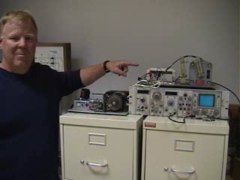
Example of Hall effect sensor used to measure speed of steel gear.
Other uses include
Magnetic switch (bicycle speedometer)
Position detection of components: eg home position of linear motion.

